Slide 1


AUGMENTED REALITY
Presented By: Koushik Biswas
ID: 2101029
Department: Internet of Things And Robotics Engineering
Bangabandhu Sheikh Mujibur Rahaman Digital University

Slide 2

Welcome to the World of Augmented Reality
Augmented reality (AR) blends the digital and physical worlds, revolutionizing how we interact with information and our environment. Dive into this captivating technology and explore its history, core principles, and vast applications.

Slide 3
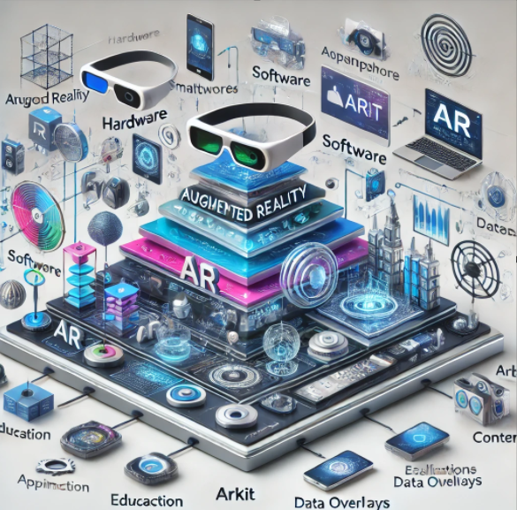
Hardware
Software
Augmented reality is deliverable in a variety of formats, including within smartphones, glasses and headsets. AR contact lenses are also in development. The technology requires hardware components, such as a processor, sensors, a display and input devices. Mobile devices, like smartphones and tablets, already have this hardware onboard, making AR more accessible to the everyday user. Mobile devices typically contain sensors, including cameras, accelerometers, Global Positioning System (GPS) instruments and solid-state compasses.
AR Development Platforms
ARKit (by Apple): Framework for AR apps on iOS.
ARCore (by Google): For Android-based AR applications.
Vuforia: Cross-platform AR SDK.
Wikitude: AR SDK for both marker-based and markerless AR.

Slide 4
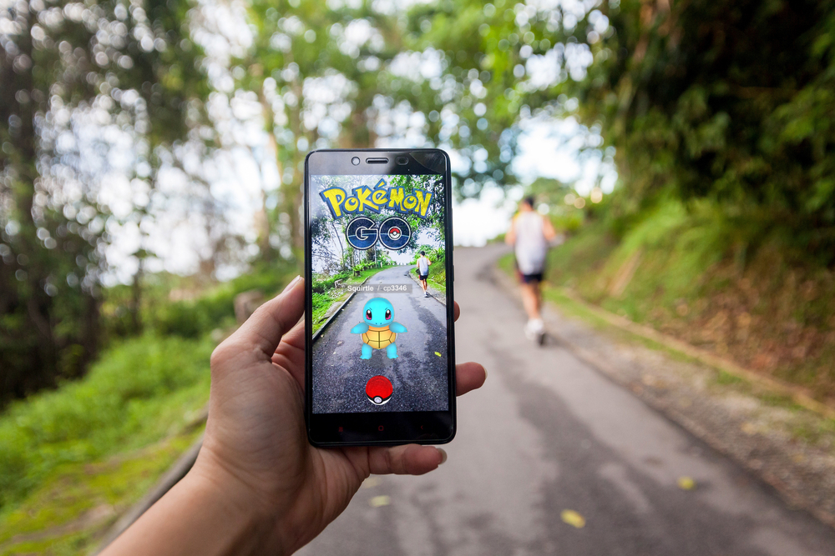
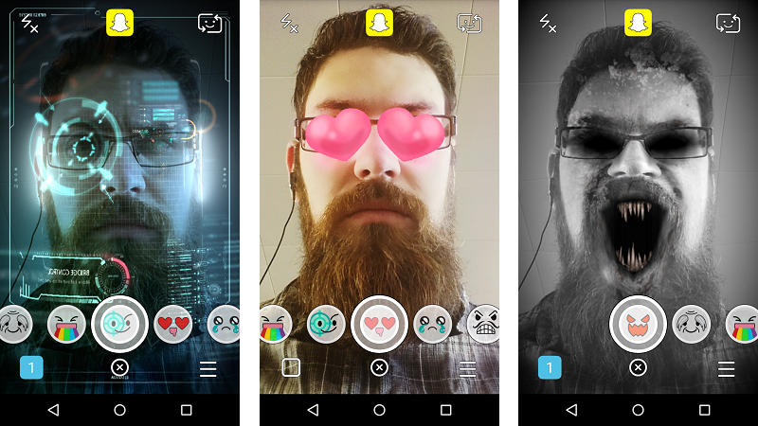
AR in Action
1
Gaming
Example: Pokémon GO – A location-based AR game that overlays digital creatures onto the real world using GPS.
Other Uses: Immersive gameplay, real-world interaction, and multiplayer experiences.
Impact: Revolutionized mobile gaming by merging virtual elements with the player's surroundings.

Slide 5
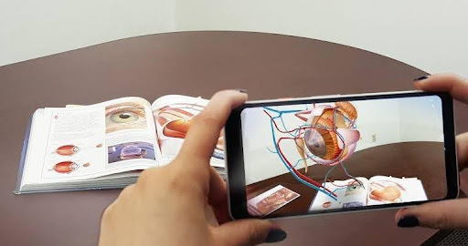
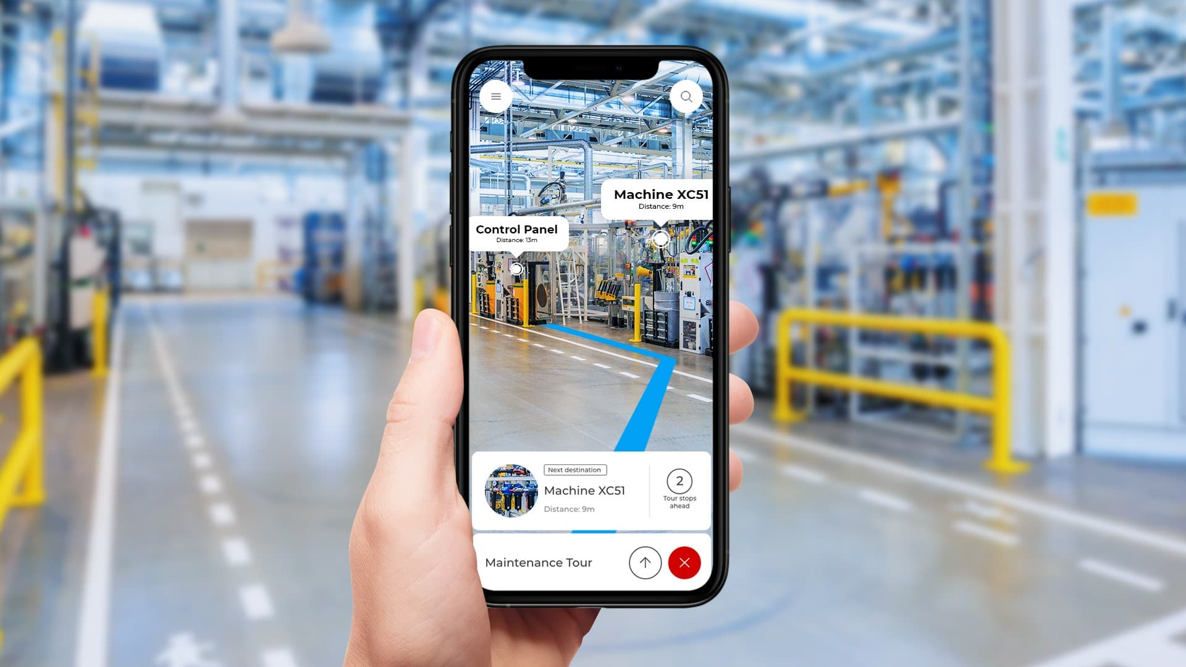
AR in Action
2
Education
Classroom Learning: Interactive AR apps for subjects like biology (e.g., 3D human anatomy).
Professional Training: AR simulations for pilots, surgeons, and engineers.
Skill Development: Hands-on practice in safe virtual environments.
Impact: Makes complex concepts easier to understand, enhances retention, and reduces risk.

Slide 6
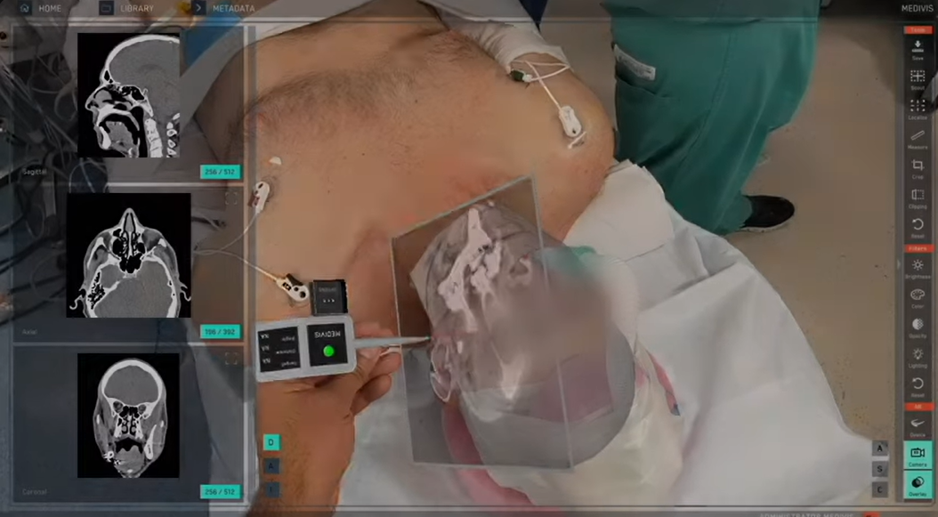
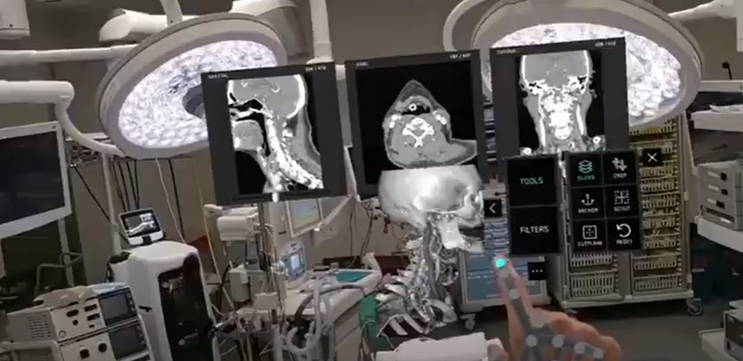
AR in Action
3
Healthcare
Surgery Assistance: AR overlays critical information like organ structures onto the patient for precision (e.g., AccuVein).
Rehabilitation and Therapy: AR games to improve motor functions in stroke patients.
Impact: Improves accuracy, reduces errors, and enhances patient outcomes.

Slide 7
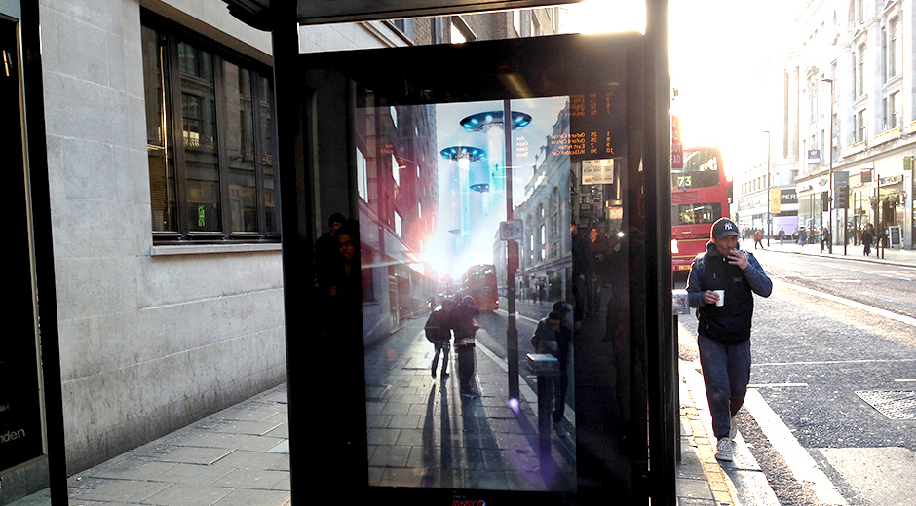

AR in Action
4
Advertising and Marketing:
Engages customers with interactive advertisements.
Example: Pepsi Max AR Bus Shelter Campaign

Slide 8
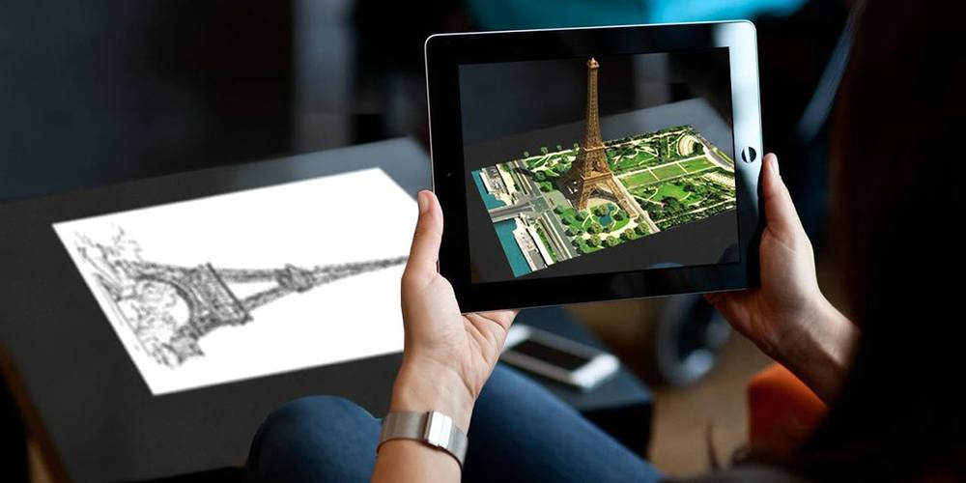
AR Flavors
1. Marker-Based AR
Definition: Uses visual markers (e.g., QR codes or distinct images) to trigger AR content.
How It Works:
A camera detects the marker.
The AR system overlays digital information on top of the marker.
Example:
AR apps that display 3D objects when a specific marker is scanned.
Advantages: High accuracy in content placement.
Limitations: Requires predefined markers for operation.

Slide 9
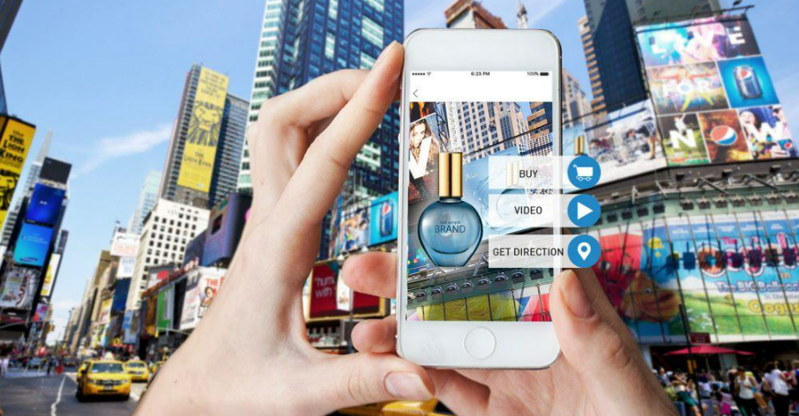
AR Flavors
2. Markerless AR
Definition: Also known as location-based AR; it doesn’t require specific markers.
How It Works:
Relies on GPS, accelerometer, or gyroscope data to detect the environment.
Example:
Pokémon GO: Overlays virtual objects in real-world locations.
Advantages: Greater flexibility and dynamic usage.
Limitations: May have lower accuracy compared to marker-based AR.

Slide 10
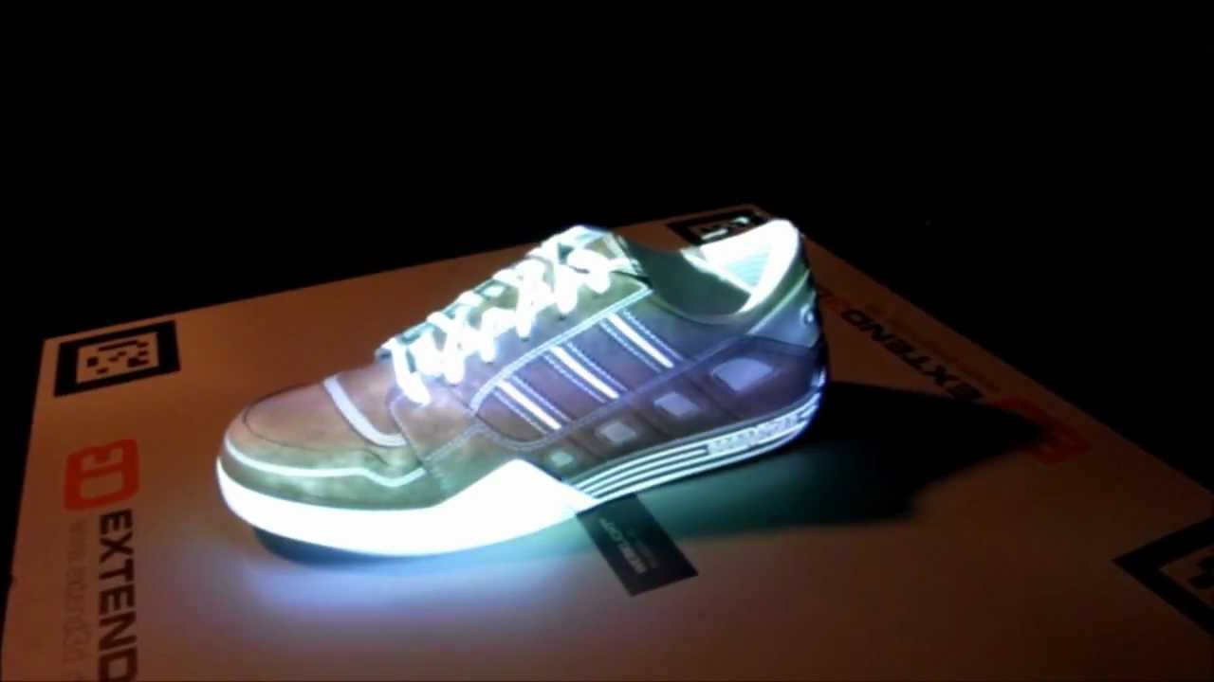
AR Flavors
3. Projection-Based AR
Definition: Projects digital content directly onto real-world surfaces.
How It Works:
AR devices use projectors to overlay images, which can interact with the physical environment.
Example:
Interactive touchscreens on walls or tables.
Advantages: No need for a display screen or handheld device.
Limitations: Limited by the surface's properties and lighting conditions.

Slide 11

AR Flavors
4. Superimposition-Based AR
Definition: Replaces or enhances parts of the real world with augmented elements.
How It Works:
Detects and superimposes virtual objects over physical objects.
Example:
Medical AR apps replacing the view of a damaged organ with a 3D model.
Advantages: Enhances understanding and visualization.
Limitations: Requires advanced image recognition and processing.

Slide 12
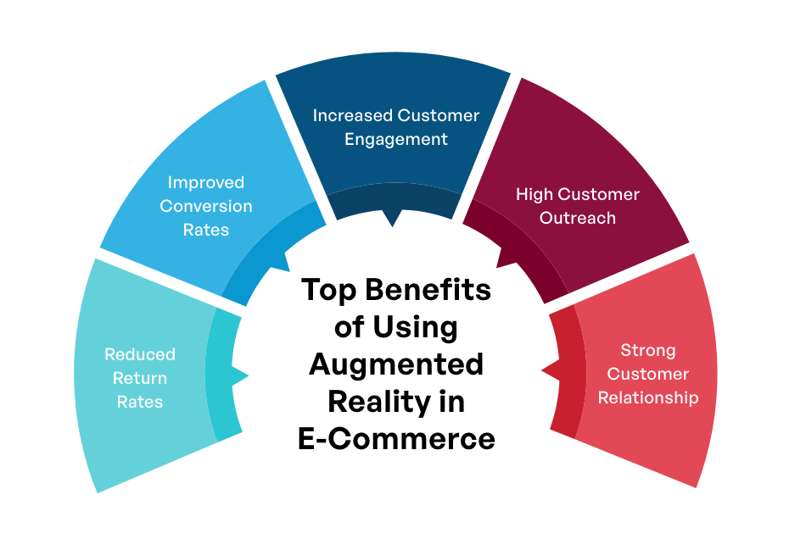

Unlocking AR's Potential
Enhanced UX
AR creates immersive and intuitive experiences, improving user engagement.
Efficiency
AR streamlines training and decision-making, boosting productivity.
Improved Decision-Making
Real-time data visualization aids in better understanding and decision-making.
Example: AR in manufacturing for troubleshooting and maintenance.

Slide 13

The Future of AR
1
AI Integration
AR will seamlessly integrate with AI to create even more intelligent and responsive experiences.
2
Metaverse Role
AR will play a crucial role in the emerging Metaverse, bridging the digital-physical divide.
3
Hardware Advances
Lightweight AR glasses and smart lenses will enable more natural and ubiquitous AR interactions.

Slide 14


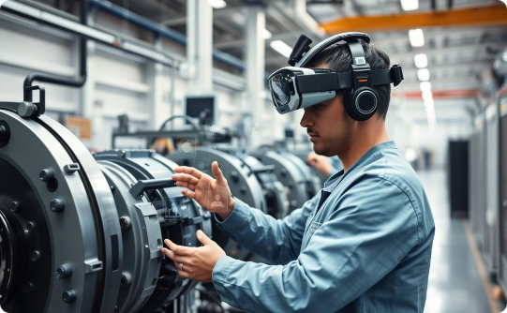
Pioneering AR Applications
Retail
Healthcare
Industry
AR enhances the shopping experience with virtual try-ons and product visualization.
AR aids surgeons, provides therapy, and improves patient outcomes.
AR streamlines assembly, maintenance, and training in industrial settings.

Slide 15




Embracing the AR Revolution
1
Innovate
2
Transform
3
Engage
4
Explore
As we stand at the cusp of the AR revolution, the possibilities are endless. Embrace this transformative technology and unlock new frontiers of innovation, engagement, and growth.

Slide 16
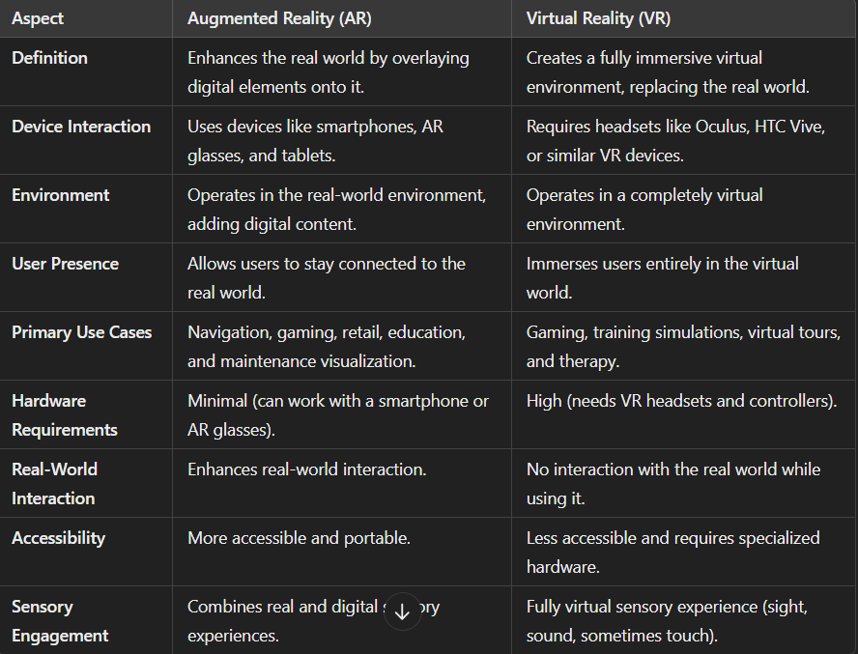

Slide 17


